Slide 1
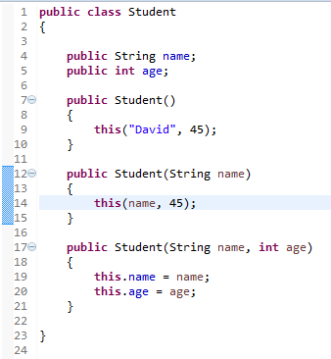
Using this with a Constructor
From within a constructor, you can also use the this keyword to call another constructor in the same class. Doing so is called an explicit constructor invocation

